Slide 1


Balancing Performance and Resource-Awareness: Optimizing the Model Selection and Ensemble Process in Machine Learning
Master‘s Theses Update
by Niklas Diller (Computing in the Humanities) on 23.08.2023

Slide 2
Outline
Motivation
Related Work
Approach
Research Question, Hypotheses and Title
Project Plan

Slide 3
Recap
How to optimize Model Set Retrieval process?
Ensembles as output to increase overall performance ➔ Implementation of Model Ensembles
Using weights to make more precise calculations for Alignment-Levels ➔ Definition of new Level System
Show only models trained on same farms, sensor systems,… ➔ Adding filters to improve UX
Evaluation by comparing metrics using both versions of the Model Retrieval System
Notes:
1. Until now: Look at output of the different models in a model set and consider, which prediction seems the most likely one -> Highly error prone/not precise/possibly many contradictions between single models
-> Introduce Model Ensembles that give one prediction on the basis of multiple models in the Ensemble (Many different methods for ensembles, will have to settle on one for implementation) Most focus in theses will probably be here.
2. Until now: Levels pretty static: A level is either reached or not reached -> Unfair comparison/actual differences in one level are too big.
-> Work with sub-levels (finer subdivision of levels, but maybe short-sighted) or work with weights: How much % of a level is reached, how much will one level influence the other upcoming levels?
3. Until now: User can only input treshold/contraint -> Might want to specifically search for models that fulfil certain criteria
-> Filter for models that were trained on same farms/cows/sensor systems. Mayabe even filter for certain model algos, but probably not necessary
Evaluation: Accuracy, root-mean-squared error, latency, memory footprint

Slide 4
Recap
How to optimize Model Set Retrieval process?
Ensembles as output to increase overall performance ➔ Implementation of Model Ensembles
Using weights to make more precise calculations for Alignment-Levels ➔ Definition of new Level System
Show only models trained on same farms, sensor systems,… ➔ Adding filters to improve UX
Evaluation by comparing metrics using both versions of the Model Retrieval System
Notes:
1. Until now: Look at output of the different models in a model set and consider, which prediction seems the most likely one -> Highly error prone/not precise/possibly many contradictions between single models
-> Introduce Model Ensembles that give one prediction on the basis of multiple models in the Ensemble (Many different methods for ensembles, will have to settle on one for implementation) Most focus in theses will probably be here.
2. Until now: Levels pretty static: A level is either reached or not reached -> Unfair comparison/actual differences in one level are too big.
-> Work with sub-levels (finer subdivision of levels, but maybe short-sighted) or work with weights: How much % of a level is reached, how much will one level influence the other upcoming levels?
3. Until now: User can only input treshold/contraint -> Might want to specifically search for models that fulfil certain criteria
-> Filter for models that were trained on same farms/cows/sensor systems. Mayabe even filter for certain model algos, but probably not necessary
Evaluation: Accuracy, root-mean-squared error, latency, memory footprint

Slide 5
Ensembles
= Constructing a set of learners, combining them to solve prediction problem
PerCom: There is a set, but no combination yet
Bagging: Combining the predictions of different models trained on different subsets of training data
Boosting: Turning weak learner into strong learner by focusing on false classifications
Voting: Results of models are aggregated; best/most common one is chosen
Classifiers in Ensemble must be accurate and diverse at the same time ➔ Balancing Act: Resource Awareness vs. Diversity
Notes:
Bagging:
Boosting: Dependent method; classifiers build on each other
Voting the most straight forward approach in this case
I don’t know how much focus I will be able to set in diversity: Rather complex, but important to show this duality

Slide 6
Voting
Majority Voting: Class that got more than half of all votes is chosen; else: Rejection Option
Plurality Voting: Class that got the most votes is chosen
Weighted Voting: Assigning weights proportional to accuracy of model
Notes:
Bagging:
Boosting: Dependent method; classifiers build on each other
Voting the most straight forward approach in this case
I don’t know how much focus I will be able to set in diversity: Rather complex, but important to show this duality

Slide 7
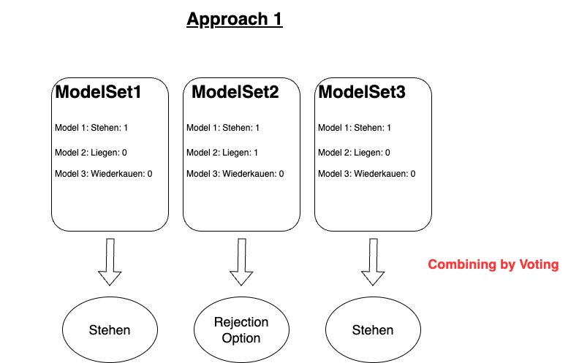
Approach Option 1:
Looking at results of each Model Set:
Combining the results and giving one answer per Model Set
Notes:
Ich brauch ein Beispiel für den eigenltichen output der Modelle: Wo steht, wie wahrscheinlich das Stehen, Grasen etc. grade ist? Auf GitLab sehe ich nur den Output des Model Miners.
Easy way, but does it make sense?

Slide 8
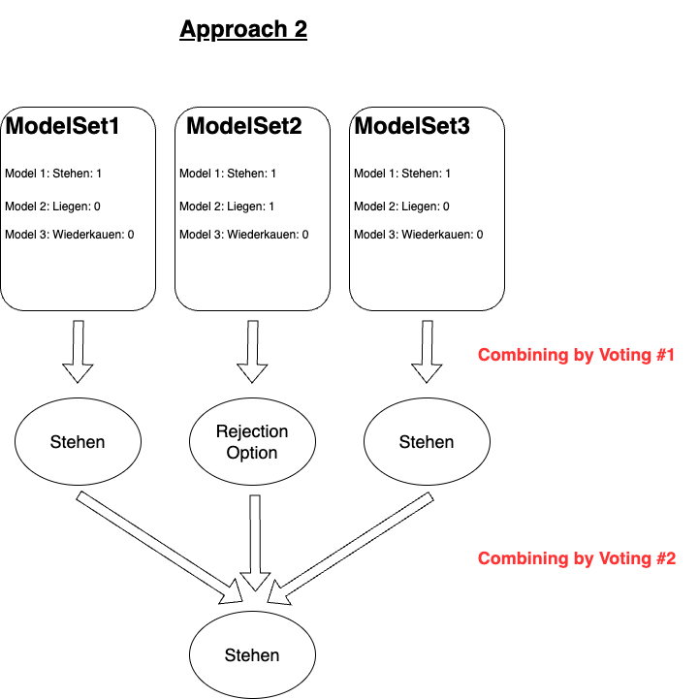
Approach Option 2:
Looking at results of each Model Set:
Combining the results again and giving one answer for all Model Sets
Notes:
Ich brauch ein Beispiel für den eigenltichen output der Modelle: Wo steht, wie wahrscheinlich das Stehen, Grasen etc. grade ist? Auf GitLab sehe ich nur den Output des Model Miners.
Easy way, but does it make sense?

Slide 9
Approach Option 3: Reconstruction of Model Miner
Instead of getting multiple Model Sets that each contain partially the same Models, construct and return 1 Ensemble per Label
Ensemble Size is selectable in Model Miner
Output: M Ensembles each containing N classifiers of the same type (same labels to be predicted) where M is the number of labels and N is the Ensemble size selected by the user
➔ Prediction for each Ensemble combined by voting; Result of each Ensemble either presented on it’s own, or comparison of Ensemble results and combining those (like in Approach 2)
Notes:
Ich brauch ein Beispiel für den eigenltichen output der Modelle: Wo steht, wie wahrscheinlich das Stehen, Grasen etc. grade ist? Auf GitLab sehe ich nur den Output des Model Miners.
This is the way, I see it. Open for other inputs / solution possibilities

Slide 10
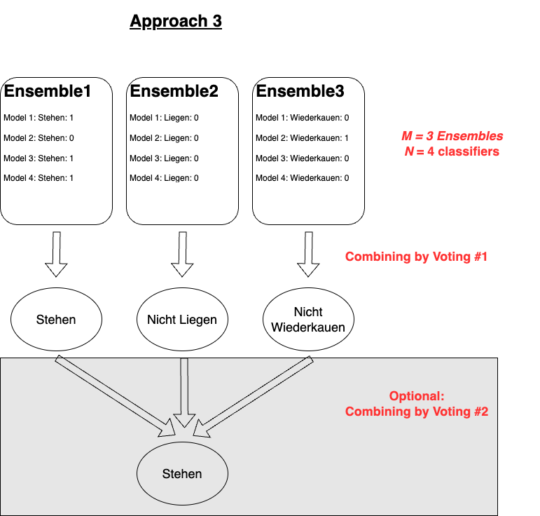
Approach Option 3: Reconstruction of Model Miner
Notes:
Ich brauch ein Beispiel für den eigenltichen output der Modelle: Wo steht, wie wahrscheinlich das Stehen, Grasen etc. grade ist? Auf GitLab sehe ich nur den Output des Model Miners.
This is the way, I see it. Open for other inputs / solution possibilities

Slide 11
Ideas & Considerations
Filter, to only construct homogenous Ensembles
Select the desired ML Algorithm beforehand
Selection of preferred Voting Method
Majority Voting: Behaviour at Rejection Option
Use Plurality Voting Instead
Add/Remove I more models to Ensemble and re-classify
Use prediction of model/Ensemble with highest accuracy

Slide 12
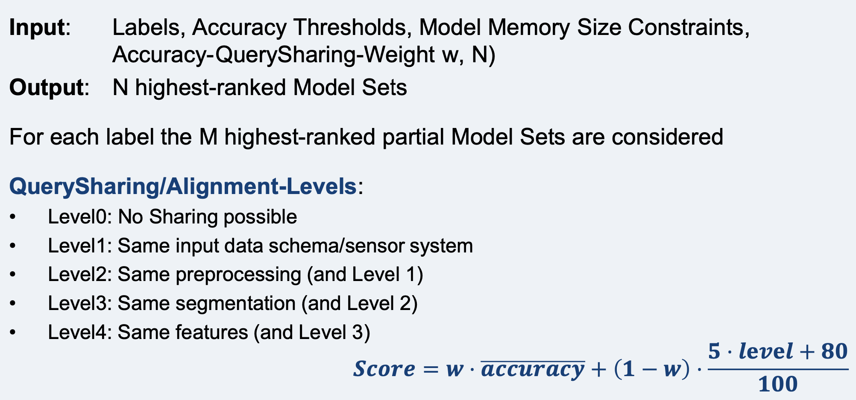
Current approach lacks performance but has potential
Notes:
Screenshot of PerCom slides
Decription of Model Set Minder
Has potential for improvisation
1. Until now: Look at output of the different models in a model set and consider, which prediction seems the most likely one -> Highly error prone/not precise/possibly many contradictions between single models
2. Until now: Levels pretty static: A level is either reached or not reached -> Unfair comparison/actual differences in one level are too big.
3. Until now: User can only input treshold/contraint -> Might want to specifically search for models that fulfil certain criteria

Slide 13
Research Question and Hypothesis Proposals
How Does Optimizing the Selection and Ensembling Process for Machine Learning Models Support the Resource-Awareness of Machine-Learning-Based Data Stream Processing?
Creating Ensembles Out of a Model Registry Instead of Looking at a Model Set Consisting of Multiple Single Models Increases the Performance of the Classifying Process.
Constructing a Level- and Weight-Based System for Determining the Similarities Between Models Improves the Resource Awareness of the Classifier.
Adding Filters In the Model Retrieval System Helps To Save Resources Without Decreasing the Accuracy of the Classifier.
Notes:
Derived different hypotheses from the approach that can be summarized under one big research question
Especially third hypothesis hard to prove

Slide 14
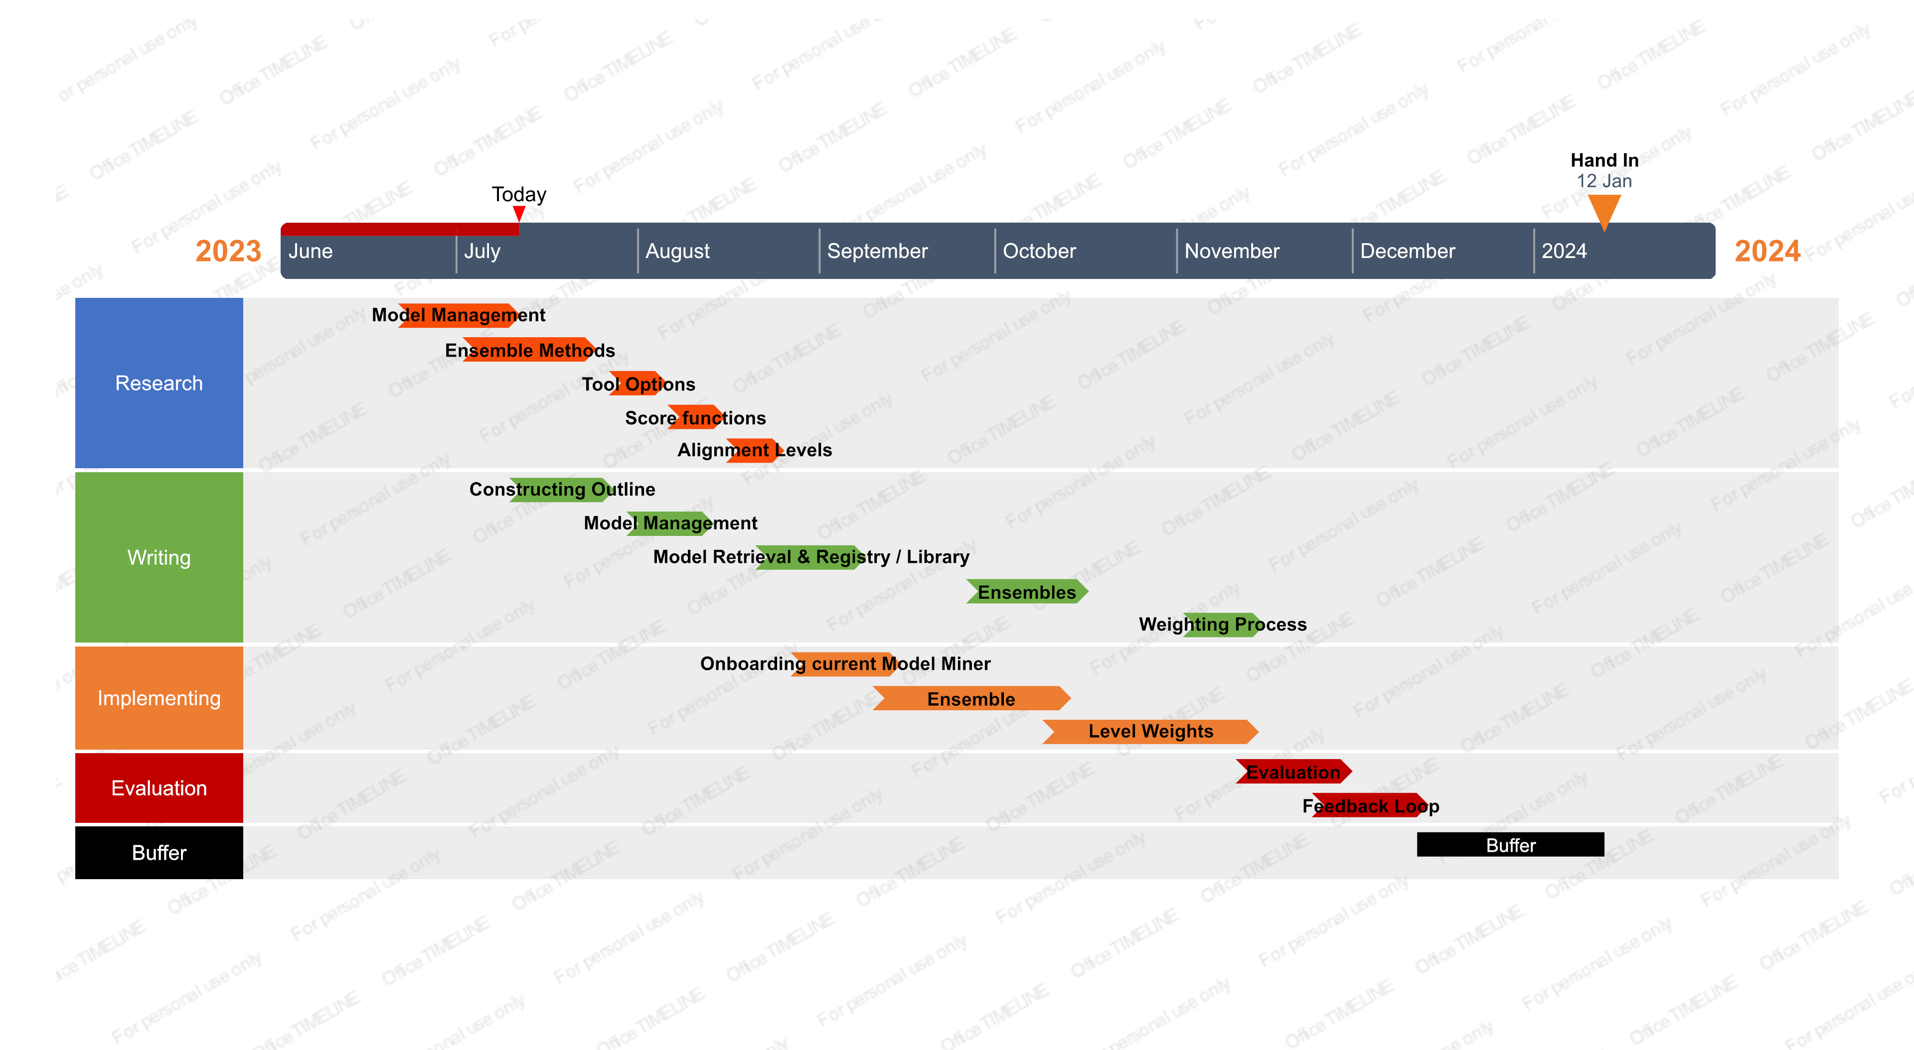
Project Plan

